Slide 1
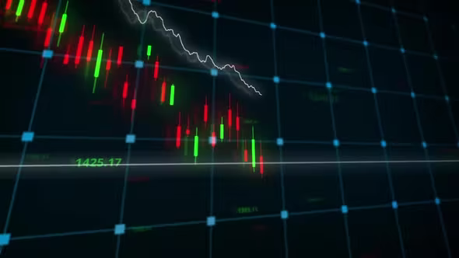
Stock Market Prediction Using Machine Learning
Team Members :
1.Shivam Mishra (201903029)
2.Mitesh Rege (201903038)
3.Prajna Shetty (201903046)
Grp No : 03
XIE TE IT
GUIDE :
Prof Chhaya Dhavale

Slide 2
What is Stock Market ?
A stock market is a public market where you can buy and sell shares for publicly listed companies. The stocks, also known as equities, represent ownership in the company.
“Stock market is a place where selling and purchasing can provide future aims of life .”
by Kang Zhang et al, 2019.

Slide 3
MACHINE LEARNING
ML is the field of study that gives computers the capability to learn without being explicitly programmed.
ML is one of the most exciting technologies that one would have ever come across.
As it is evident from the name, it gives the computer that makes it more similar to humans the ability to learn.

Slide 4
Problem Statement
Everyone want to be rich in his life with low efforts and great advantages.
Because of pandemic the demand of Stock have become huge
Prediction and Analysing stock can benefit People to think before buying or selling stocks.
So the project idea is to predict Stock prices( or we can say trends prediction in stock prices ) to gain significant profit .

Slide 5
OBJECTIVES
In Stock Market Prediction, the aim is to predict the future value of the financial stocks of a company.
We attempt to implement machine learning approach to predict stock prices.
We propose a stock price prediction system that integrates mathematical functions, machine learning, and other external factors for the purpose of achieving better stock prediction accuracy and issuing profitable trades.

Slide 6
DATASET DESCRIPTION
Pandas Datareader is a Python package that allows us to create a pandas DataFrame object by using various data sources from the internet.
It is popularly used for working with realtime stock price datasets.
Tiingo
Tiingo is a tracing platform that provides a data api with historical end-of-day prices on equities, mutual funds and ETFs.
Free registration is required to get an API key. Free accounts are rate limited and can access 50 times a day

Slide 7
LITERATURE SURVEY
Obthong, M., Tantisantiwong, N., Jeamwatthanachai, W., & Wills, G. B. (2020, May). A Survey on Machine Learning for Stock Price Prediction: Algorithms and Techniques. In FEMIB (pp. 63-71).
Stock market trading is an activity in which investors need fast and accurate information to make effective decisions. Since many stocks are traded on a stock exchange, numerous factors influence the decision-making process.
Babu, M. S., Geethanjali, N., & Satyanarayana, B. (2012). Clustering approach to stock market prediction. International Journal of Advanced Networking and Applications, 3(4), 1281.
This paper analyze the major clustering algorithms: K-Means, Hierarchical clustering algorithm and reverse K means and compare the performance of these three major clustering algorithms on the aspect of correctly class wise cluster building ability of algorithm.
Q1 Identify from given research paper which are important AI building blocks are applied.
Ans :

Slide 8
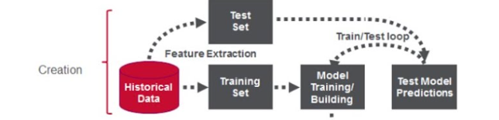
Project Work-Flow / Life Cycle
Q2 Illustrate how it’s being used (Application)
Ans :
1.Import of Necessary Packages
2.Read the Dataset
3.Exploratory Data Analysis i.e. finding null values, duplicate values , data wrangling , transformation and also visualization etc.
4. Selecting Features (X) and the Target (y) columns train Test Split will split the whole dataset into train and test data
5. Build the model i.e. Training the model
6.Test the model i.e. Model prediction
7. Evaluation of the system i.e. Accuracy score, F1- score etc.

Slide 9
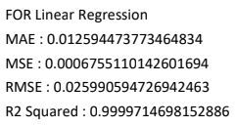
ALGORITHMS USED AND
RESULTS
Linear Regression
KNN
Decision Tree
Linear Regression
Linear regression is supervised ml algorithm
Linear regression makes predictions for continuous/real or numeric variables such as sales, salary, age, product price, etc.
Linear regression algorithm shows a linear relationship between a dependent (y) and one or moreindependent (y) variables, hence called as linear regression.
Since linear regression shows the linear relationship, which means it finds how the value of the dependent variable is changing according to the value of the independent variable.

Slide 10
K-Nearest Neighbor(KNN)
K-nearest neighbor or K-NN algorithm basically creates an imaginary boundary to classify the data.
When new data points come in, the algorithm will try to predict that to the nearest of the boundary line.
Note: It’s very important to have the right k-value when analyzing the dataset to avoid overfitting and underfitting of the dataset.
Using the k-nearest neighbor algorithm we fit the historical data (or train the model) and predict the future.

Slide 11
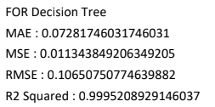
DECISION TREE
Decision tree builds regression or classification models in the form of a tree structure.
It breaks down a dataset into smaller and smaller subsets while at the same time an associated decision tree is incrementally developed.
The final result is a tree with decision nodes and leaf nodes.

Slide 12
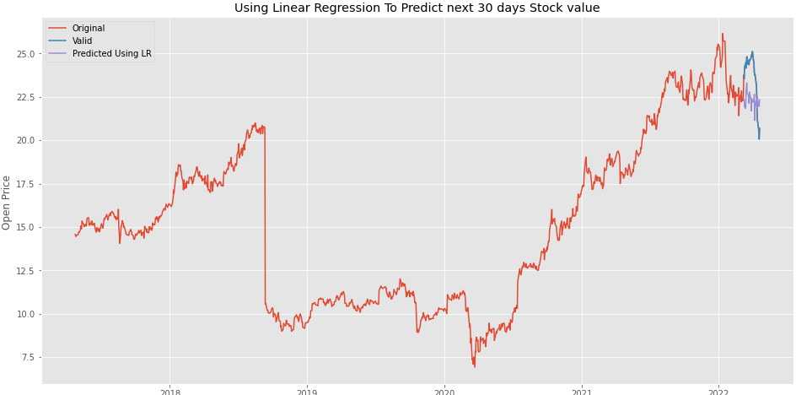
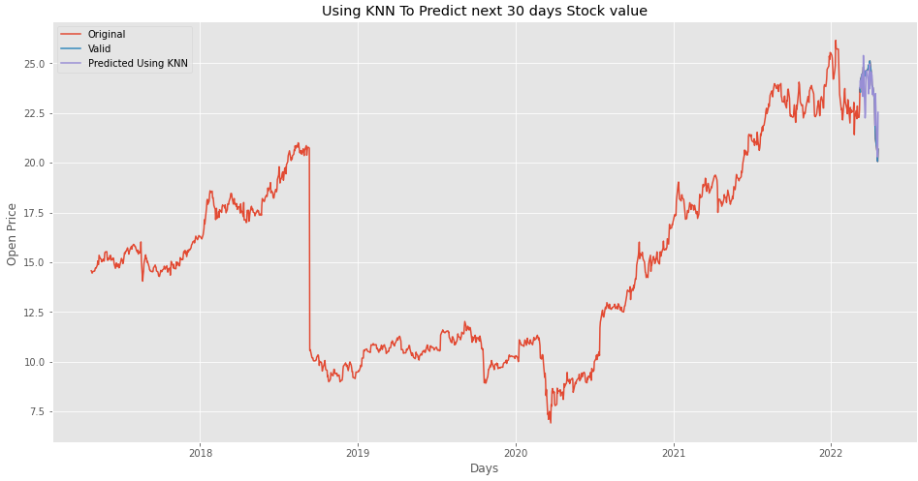
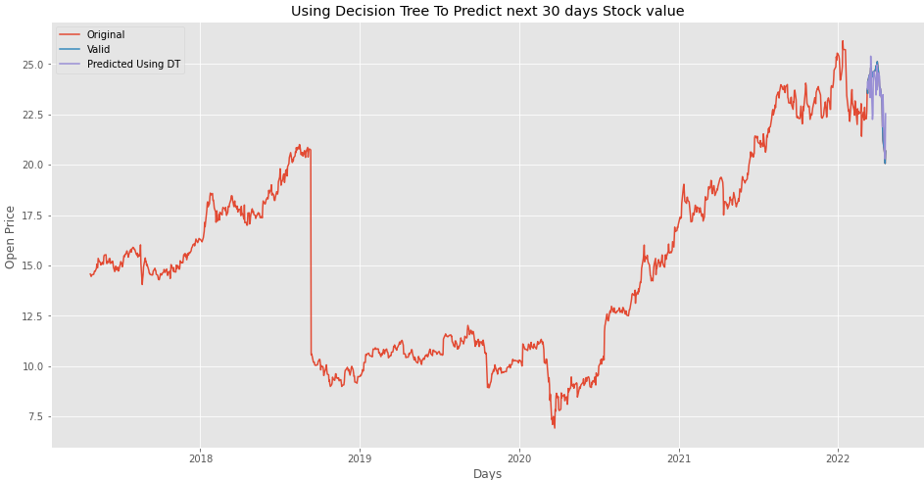
Predicting Future 30 Days Using Various Algorithms

Slide 13
COLAB
https://colab.research.google.com/drive/1-Aem_tSGWq6-xMJ_bx1LwgxjSU8D07qh?usp=sharing

Slide 14
Time Series Analysis
Time series analysis is a specific way of analyzing a sequence of data points collected over an interval of time.
In time series analysis, analysts record data points at consistent intervals over a set period of time rather than just recording the data points intermittently or randomly.

Slide 15
CONCLUSION
This project provides a review and comparative analysis of different stock market prediction parameter techniques. These techniques are used to evaluate stock market performance and trends. The stock market forecasting system is to increase accuracy. In this study we have used 3 Algorithm/ approach to improve the prediction of the results of stock , they are Linear Regression , Decision Tree and Random Forest it means we will combine two or more methods to construct a novel approach method. User can give input as any dates for above 4 mentioned companies and he has to give for how many days in future he wants stock prices and our model predicts stock for specific companies for user mentioned days

Slide 16
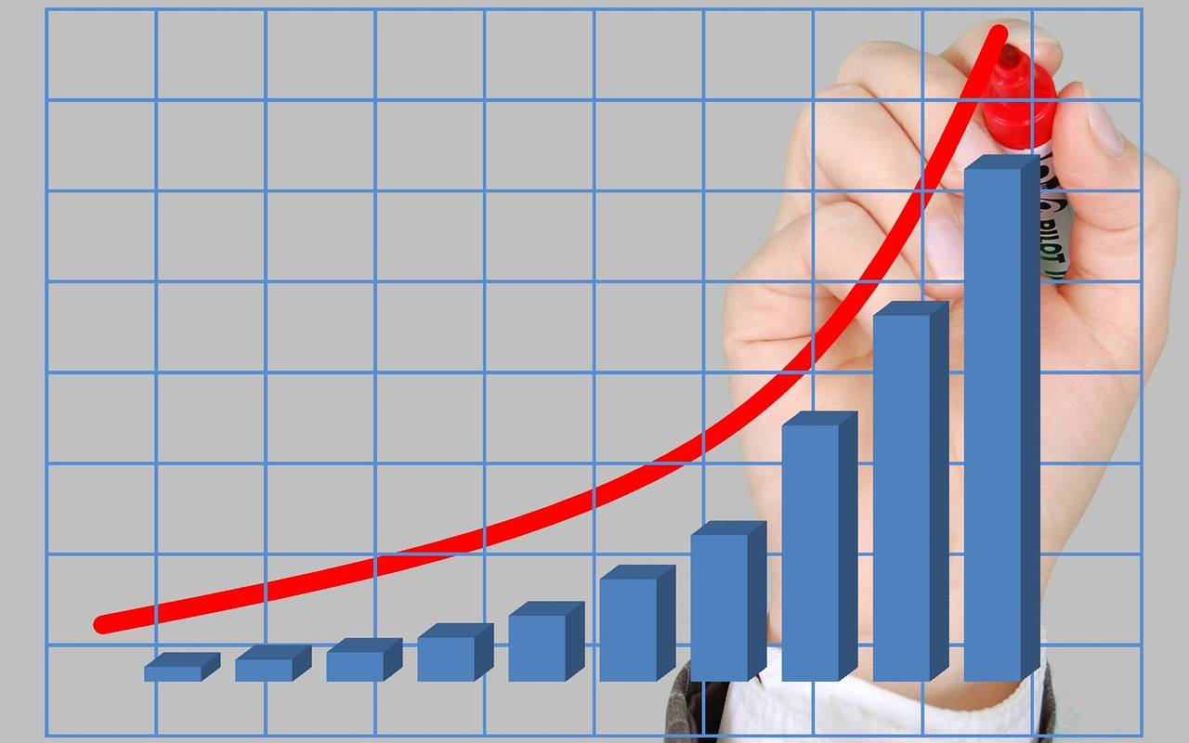
THANK YOU !!

